Slide 1


Power Track App
Solutions for Power Optimization
Group No: 03

Slide 2



Introducing Our Solution for Energy Efficiency
The main goal of our app is to make it easy for users to control their smart home devices and monitor monthly energy usage and monthly bill amount. It helps users save energy, reduce costs, and manage their homes conveniently, all from one simple and user-friendly platform.

Slide 3




Our Technology Stack
Framework
Real time Database
Flutter
Firebase
Language
IDE
Dart
Android Studio

Slide 4
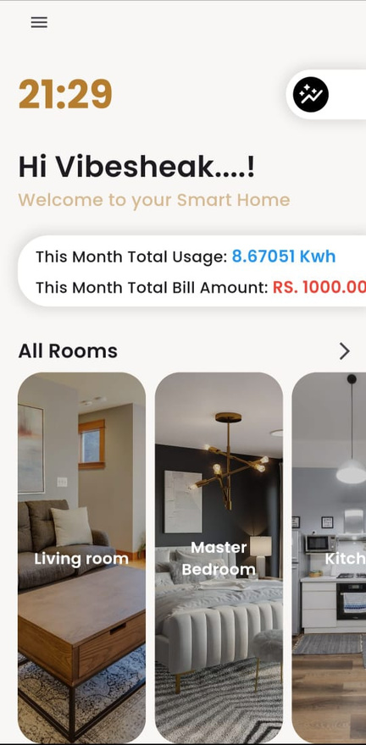
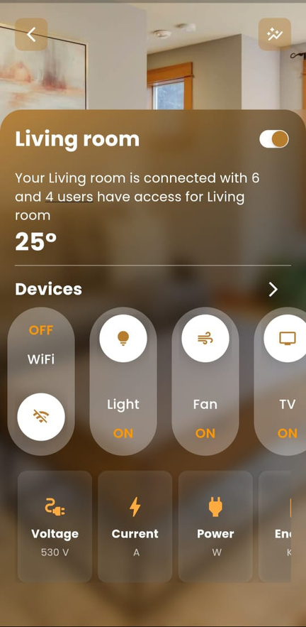
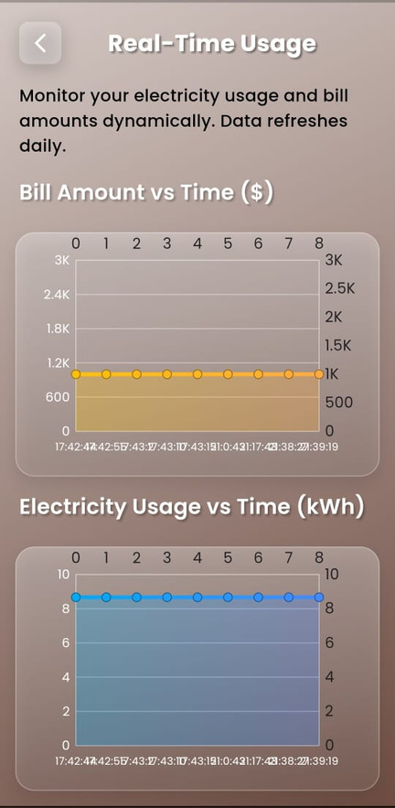
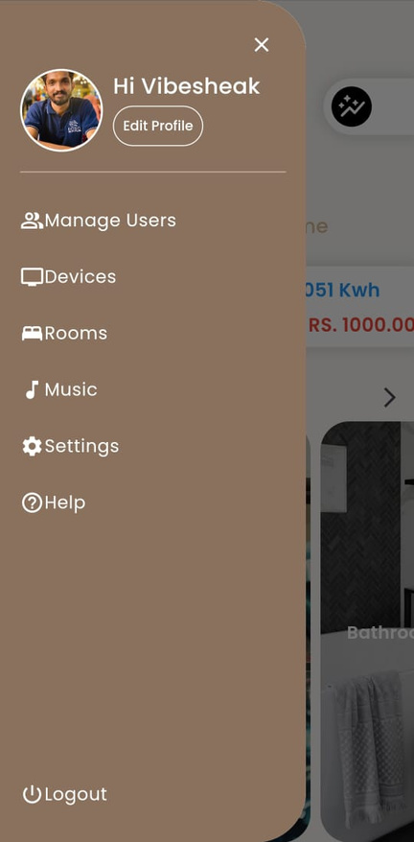
Room-Specific Control
Device Management & Energy consumption
Real-Time Monitoring
User Profile

Slide 5

Thank you !
Group No: 03
EC/2020/013 - M.Vathushan
EC/2020/022 - S.Vibesheak
EC/2020/030 - T.Jana
EC/2020/044 - B.Pirasanth
EC/2020/048 - M.Nilojitha
EC/2020/054 - T.I.Fathima

